Slide 1
Lecture-30
Mathematics 2 (15B11MA211)
CO [C106.6]
Topic: Cauchy Integral Theorem with proof
Reference for the lecture
R.K Jain and S.R.K. Iyenger, “Advanced Engineering Mathematics” fifth edition, Narosa publishing house, 2016.
B. S. Grewal, “Higher Engineering Mathematics” 42nd -Edition, Khanna Publisher, New Delhi

Slide 2
Topics Covered
Simple connected domain and multiply connected domain
Cauchy integral theorem
Examples
Independence of path
Extension of Cauchy integral theorem
Examples

Slide 3
Simple closed contour: It is a curve in which
Starting and end point coincide
No other common points; i.e. curve does not intersect or touch itself.
Example: A circle is a simple curve, A curve in the shape of 8 is not simple.
Simply connected domain: It is a region D in the complex plain such that every simple closed contour in D encloses only the points of D.
Example: The interior of a circle (open disc) is a Simply connected domain.
If a domain which is not simply connected is Multiply connected.
Doubly connected
Triply connected
Simply connected

Slide 4

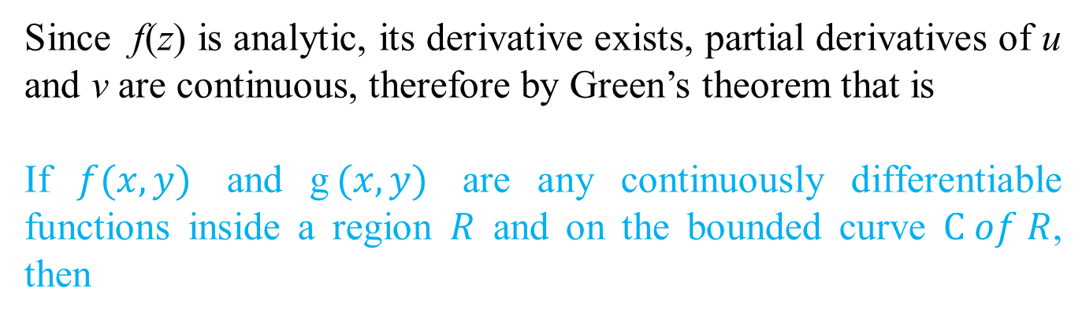
Cauchy’s Integral Theorem:
If f(z) is analytic in a simply connected domain D, then for every simple closed curve C in D
R
D
C
Proof:
Taking f(z) = u(x, y) + i v(x, y) and using dz = dx + i dy, we get
Since f(z) is analytic, its derivative exists, partial derivatives of u and v are continuous, therefore by Green’s theorem that is
If $f(x,y)$ and g$(x,y)$ are any continuously differentiable functions inside a region $R$ and on the bounded curve $C of R$, then

Slide 5
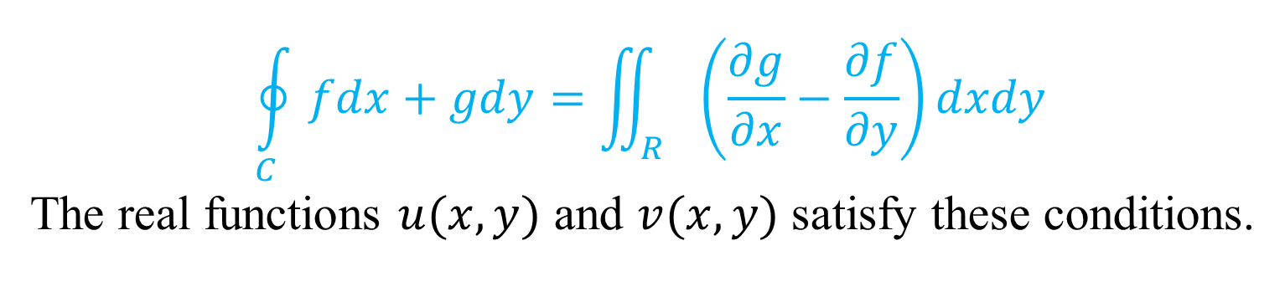
$$\oint_{C}{fdx+gdy=\iint_{R}{\left(\frac{∂g}{∂x}−\frac{∂f}{∂y}\right)dxdy}}$$
The real functions $u(x,y)$ and $v(x,y)$ satisfy these conditions.
(Because u and v satisfy Cauchy-Riemann equations.)
= 0

Slide 6
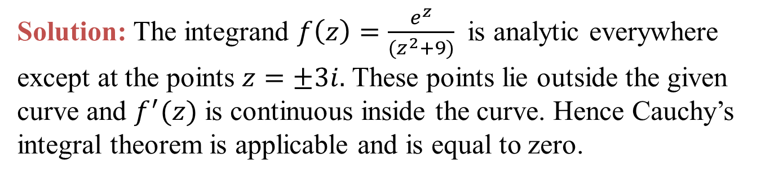
Example: Evaluate
Solution: Applying Cauchy’s integral Theorem,
Example: Evaluate
Solution: The integrand $f\left(z\right)=\frac{e^{z}}{(z^{2}+9)}$ is analytic everywhere except at the points $z=±3i.$ These points lie outside the given curve and $f^{′}(z)$ is continuous inside the curve. Hence Cauchy’s integral theorem is applicable and is equal to zero.

Slide 7



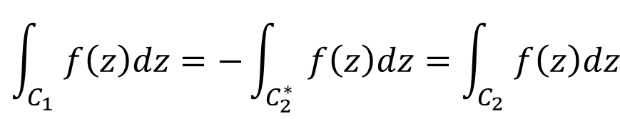
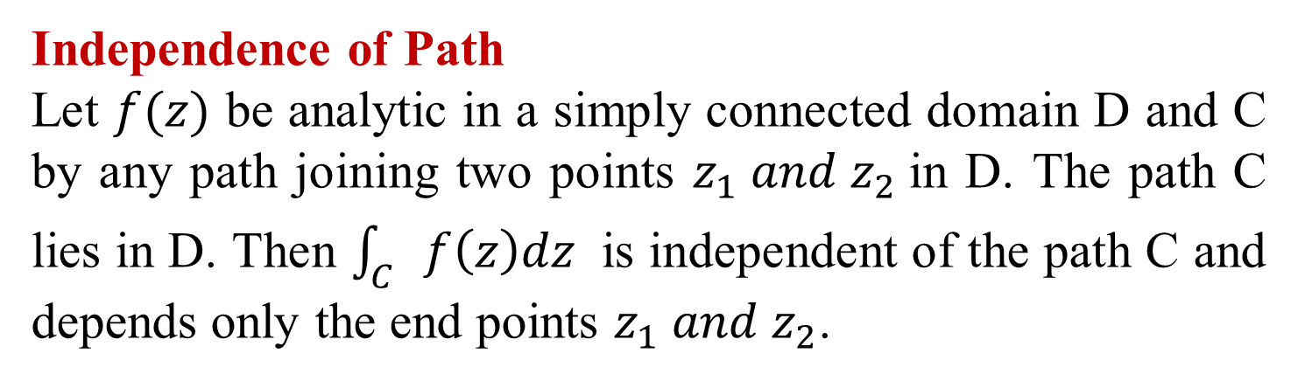

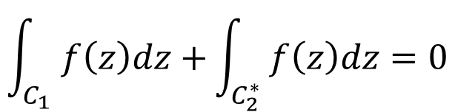




Independence of Path
Let $f(z)$ be analytic in a simply connected domain D and C by any path joining two points $z_{1} and z_{2}$in D. The path C lies in D. Then $\int_{C}{f\left(z\right)dz}$ is independent of the path C and depends only the end points $z_{1} and z_{2}$.
$$C_{1}$$
D
$$C_{1}$$
D
$$z_{1}$$
$$z_{2}$$
$$z_{1}$$
$$z_{2}$$
$$C_{2}$$
$$C_{2}^{∗}$$
$$\int_{C_{1}}{f\left(z\right)dz+}\int_{C_{2}^{∗}}{f\left(z\right)dz=0}$$
$$\int_{C_{1}}{f\left(z\right)dz=−}\int_{C_{2}^{∗}}{f\left(z\right)dz=\int_{C_{2}}{f\left(z\right)dz}}$$
=> Independence of path, depends on end points only.

Slide 8
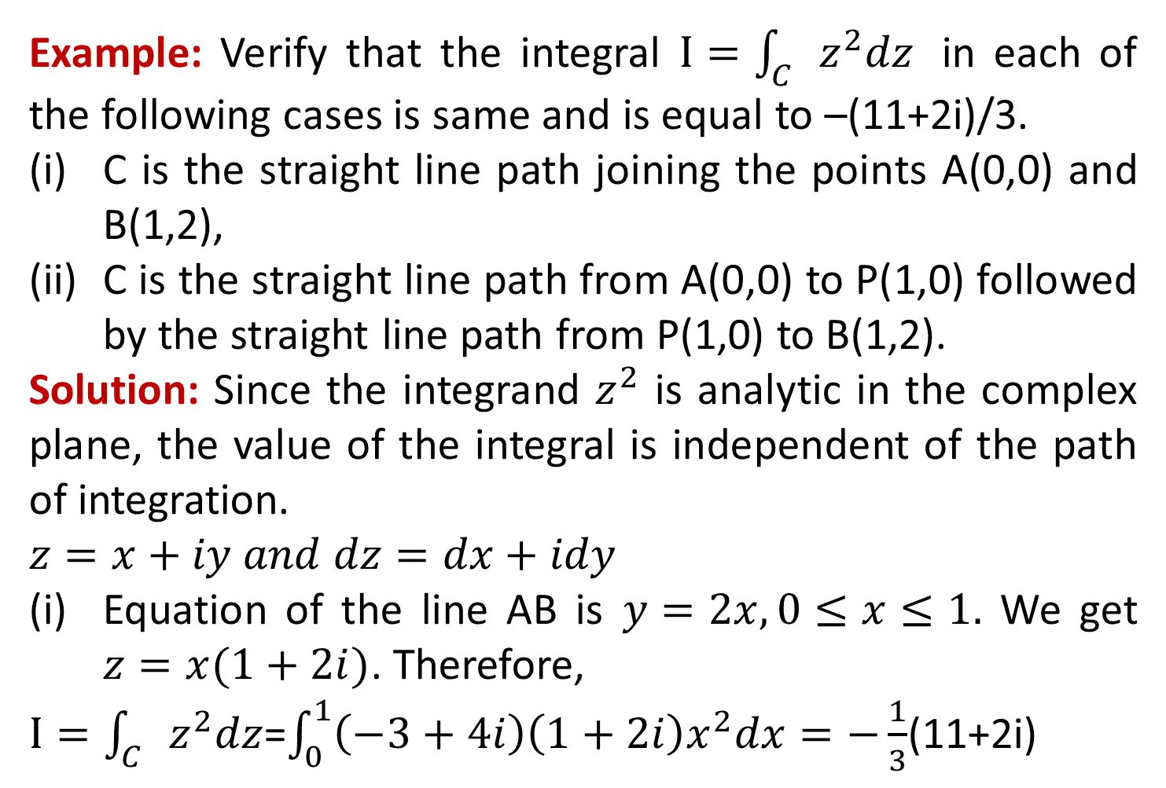
Example: Verify that the integral $I=\int_{C}{z^{2}dz}$ in each of the following cases is same and is equal to –(11+2i)/3.
C is the straight line path joining the points A(0,0) and B(1,2),
C is the straight line path from A(0,0) to P(1,0) followed by the straight line path from P(1,0) to B(1,2).
Solution: Since the integrand $z^{2}$ is analytic in the complex plane, the value of the integral is independent of the path of integration.
$$z=x+iy and dz=dx+idy$$
Equation of the line AB is $y=2x, 0≤x≤1.$ We get $z=x(1+2i)$. Therefore,
$I=\int_{C}{z^{2}dz}$=$\int_{0}^{1}{\left(−3+4i\right)\left(1+2i\right)x^{2}dx=−\frac{1}{3}}$(11+2i)

Slide 9
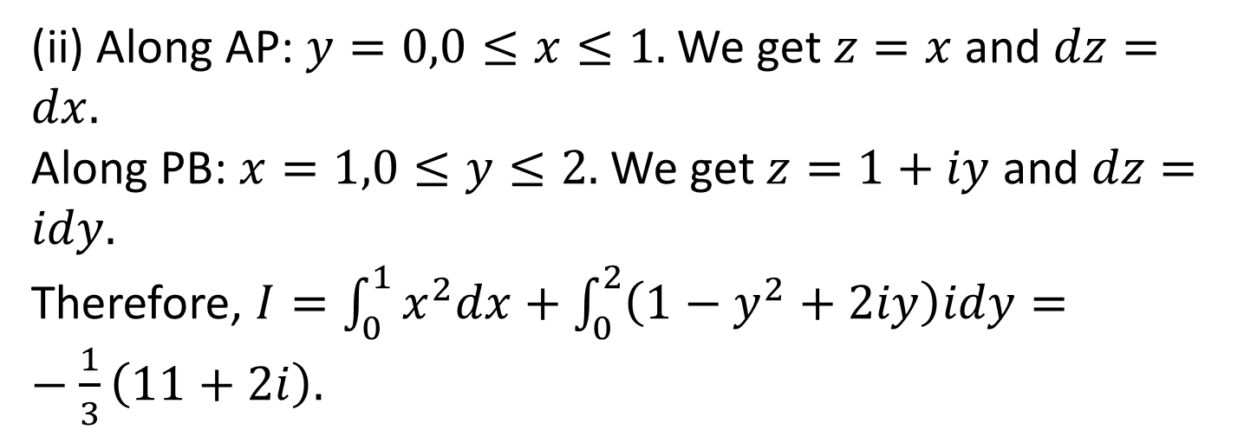
(ii) Along AP: $y=0,0≤x≤1.$We get $z=x$ and $dz=dx.$
Along PB:$x=1,0≤y≤2.$ We get $z=1+iy$ and $dz=idy.$
Therefore, $I=\int_{0}^{1}{x^{2}dx+\int_{0}^{2}{\left(1−y^{2}+2iy\right)idy}}=−\frac{1}{3}\left(11+2i\right).$

Slide 10
Extension of Cauchy’s Integral Theorem for Multiply connected domain:
If f(z) is analytic in a domain D between two simple closed curves C and C₁, then
C
C₁
C
A
B
To prove this we introduce a cross-cut AB.
Then the a simple closed curve C' consisting of AB, C₁ clockwise, BA and C anti-clockwise encloses a simply connected region. Therefore
C₁
Hence the result.

Slide 11
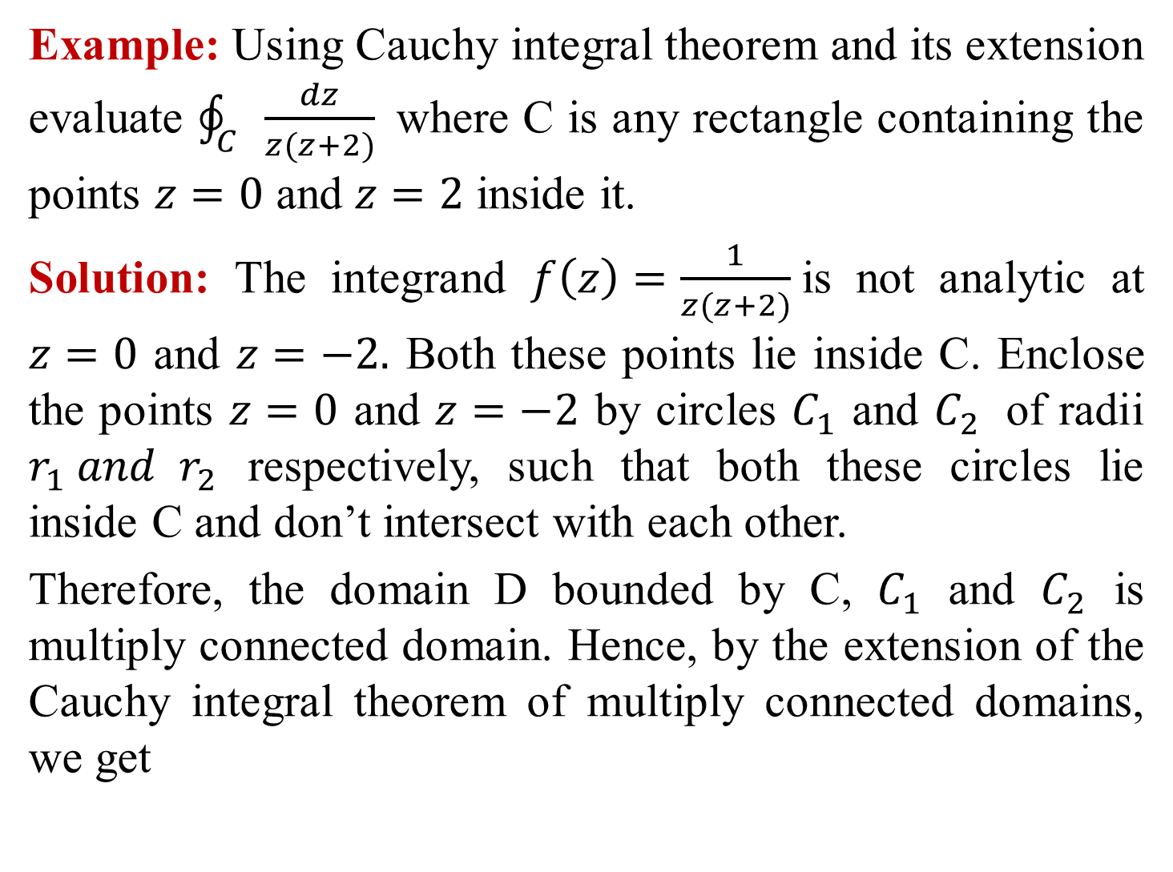
Example: Using Cauchy integral theorem and its extension evaluate $\oint_{C}{\frac{dz}{z(z+2)} }$where C is any rectangle containing the points $z=0$ and $z=2$ inside it.
Solution: The integrand $f\left(z\right)=\frac{1}{z(z+2)}$is not analytic at $z=0$ and $z=−2.$ Both these points lie inside C. Enclose the points $z=0$ and $z=−2$ by circles $C_{1}$ and $C_{2}$ of radii $r_{1} and{ r}_{2}$ respectively, such that both these circles lie inside C and don’t intersect with each other.
Therefore, the domain D bounded by C, $C_{1}$ and $C_{2}$ is multiply connected domain. Hence, by the extension of the Cauchy integral theorem of multiply connected domains, we get

Slide 12
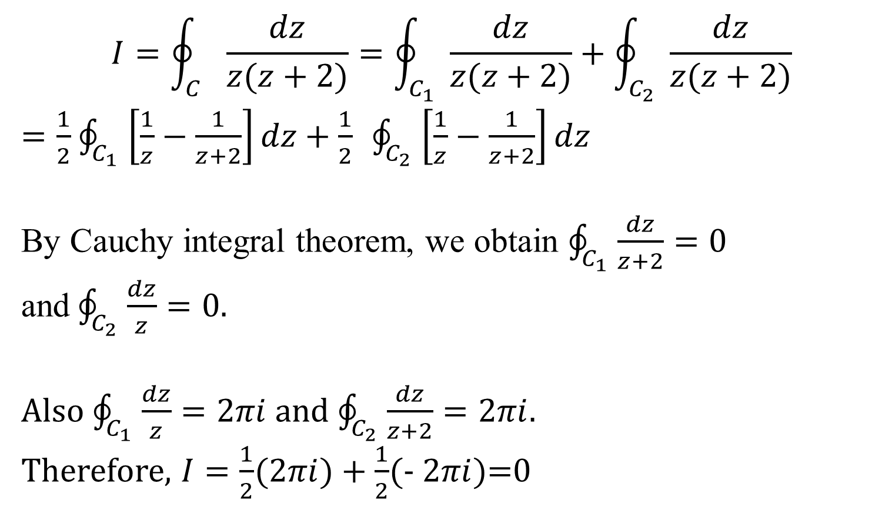
$$I=\oint_{C}{\frac{dz}{z(z+2)}=\oint_{C_{1}}{\frac{dz}{z(z+2)}+\oint_{C_{2}}{\frac{dz}{z(z+2)}}}}$$
$=\frac{1}{2}$ $\oint_{C_{1}}{\left[\frac{1}{z}−\frac{1}{z+2}\right]dz+\frac{1}{2} \oint_{C_{2}}{\left[\frac{1}{z}−\frac{1}{z+2}\right]dz}}$
By Cauchy integral theorem, we obtain $\oint_{C_{1}}{\frac{dz}{z+2}=0}$ and$\oint_{C_{2}}{\frac{dz}{z}=0}$.
Also $\oint_{C_{1}}{\frac{dz}{z}=2πi}$ and $\oint_{C_{2}}{\frac{dz}{z+2}=2πi}$.
Therefore, $I=\frac{1}{2}$(2$πi)+\frac{1}{2}$(- 2$πi$)=0

Slide 13
Thank You

